Slide 1
Geothermal Energy

Slide 2
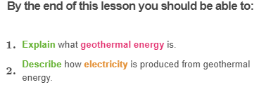
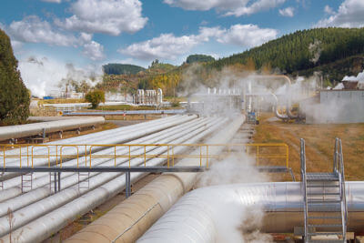

Slide 3
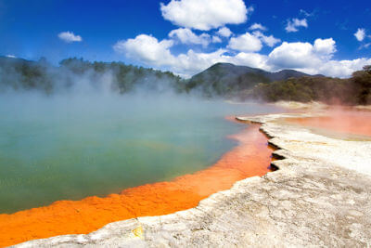
Geothermal energy comes from water that is heated deep underground.
It is a very important resource in places like Iceland and Japan, where there is volcanic activity.

Slide 4
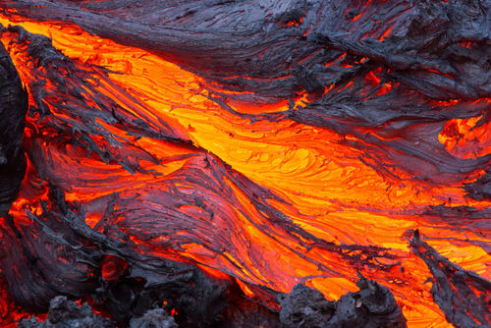
The whole Earth used to be extremely hot. Over billions of years, the Earth has gradually cooled down from the outside in.
This means that the outside of the Earth is fairly cool but the inside is really hot. The very centre of the Earth is around 7000°C!

Slide 5
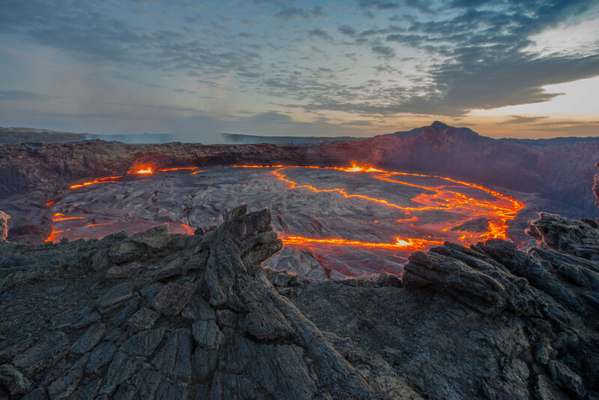
In volcanic areas, hot, molten rock forces its way up to the Earth's surface.
Molten rock is known as magma when it's underground, and lava when it breaks the surface.
This material brings heat from inside the Earth with it. Rocks in the area around the molten rock get very hot!

Slide 6
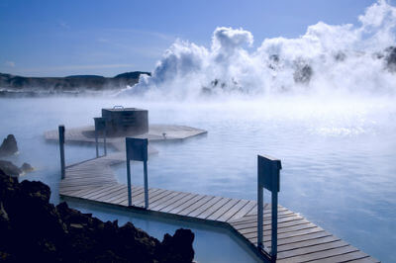
Geothermal power stations work by using these hot rocks to heat water into steam.
The steam is used to spin turbines, producing electricity.
Heated water from natural geysers can also be used in geothermal power stations. It is also used in hot pools like this one:

Slide 7
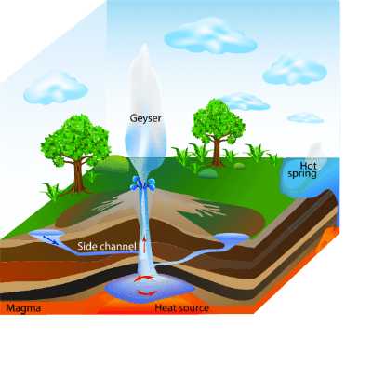
This heated water can be used in a number of ways. It can be used directly and indirectly to generate electricity.
In some areas around the world (like Iceland, Japan and New Zealand) the heat lies fairly close to the surface and heated water can come through the surface.
This heat can be used to generate electricity directly.

Slide 8
Indirectly, geothermal energy can be used by pumping water underground through drilled channels to circulate it through hot rock.
The water is heated up by the rock and is used to generate electricity when it returns to the surface. This takes place at a geothermal power station like the one below.

Slide 9
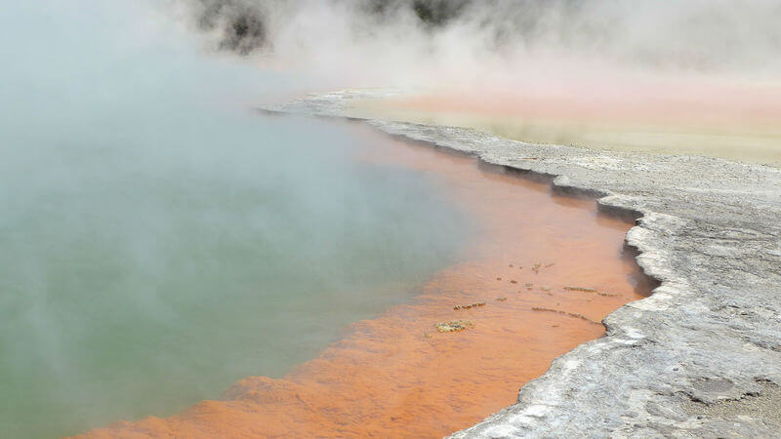
This is a very sustainable way to generate electricity as it uses natural resources.
However, it is only limited to specific areas around the world.
These are geothermal springs in Rotorua, New Zealand.

